Slide 1

Quality Data Secures Better Tomorrow

Slide 2
Problem Identification
Special Required Data Collection
Manual Data Collection
Difficulty in Information Flow
Merging MIS & Accounting
Analyzing & Summary

Slide 3

“
Real time visualization of data to take effective, sustainable and universally understandable solution
”

Slide 4
Why Are We Different?
App-based Questionnaire
Analyzing Data
Opportunity Atlas
Web-based Real time Database
Easy Information Flow

Slide 5
Why Are We Different?
App-based Questionnaire
Analyzing Data
Opportunity Atlas
Web-based Real time Database
Easy Information Flow

Slide 6
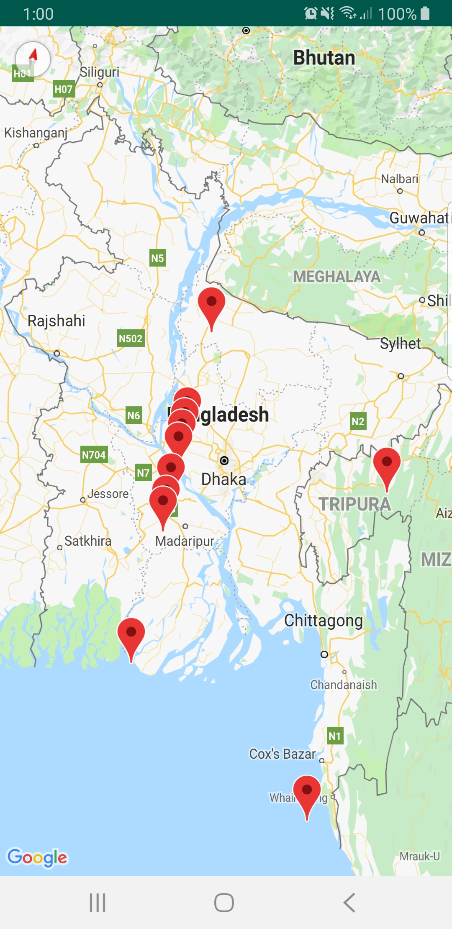



Opportunity Atlas
Place your screenshot here

Slide 7
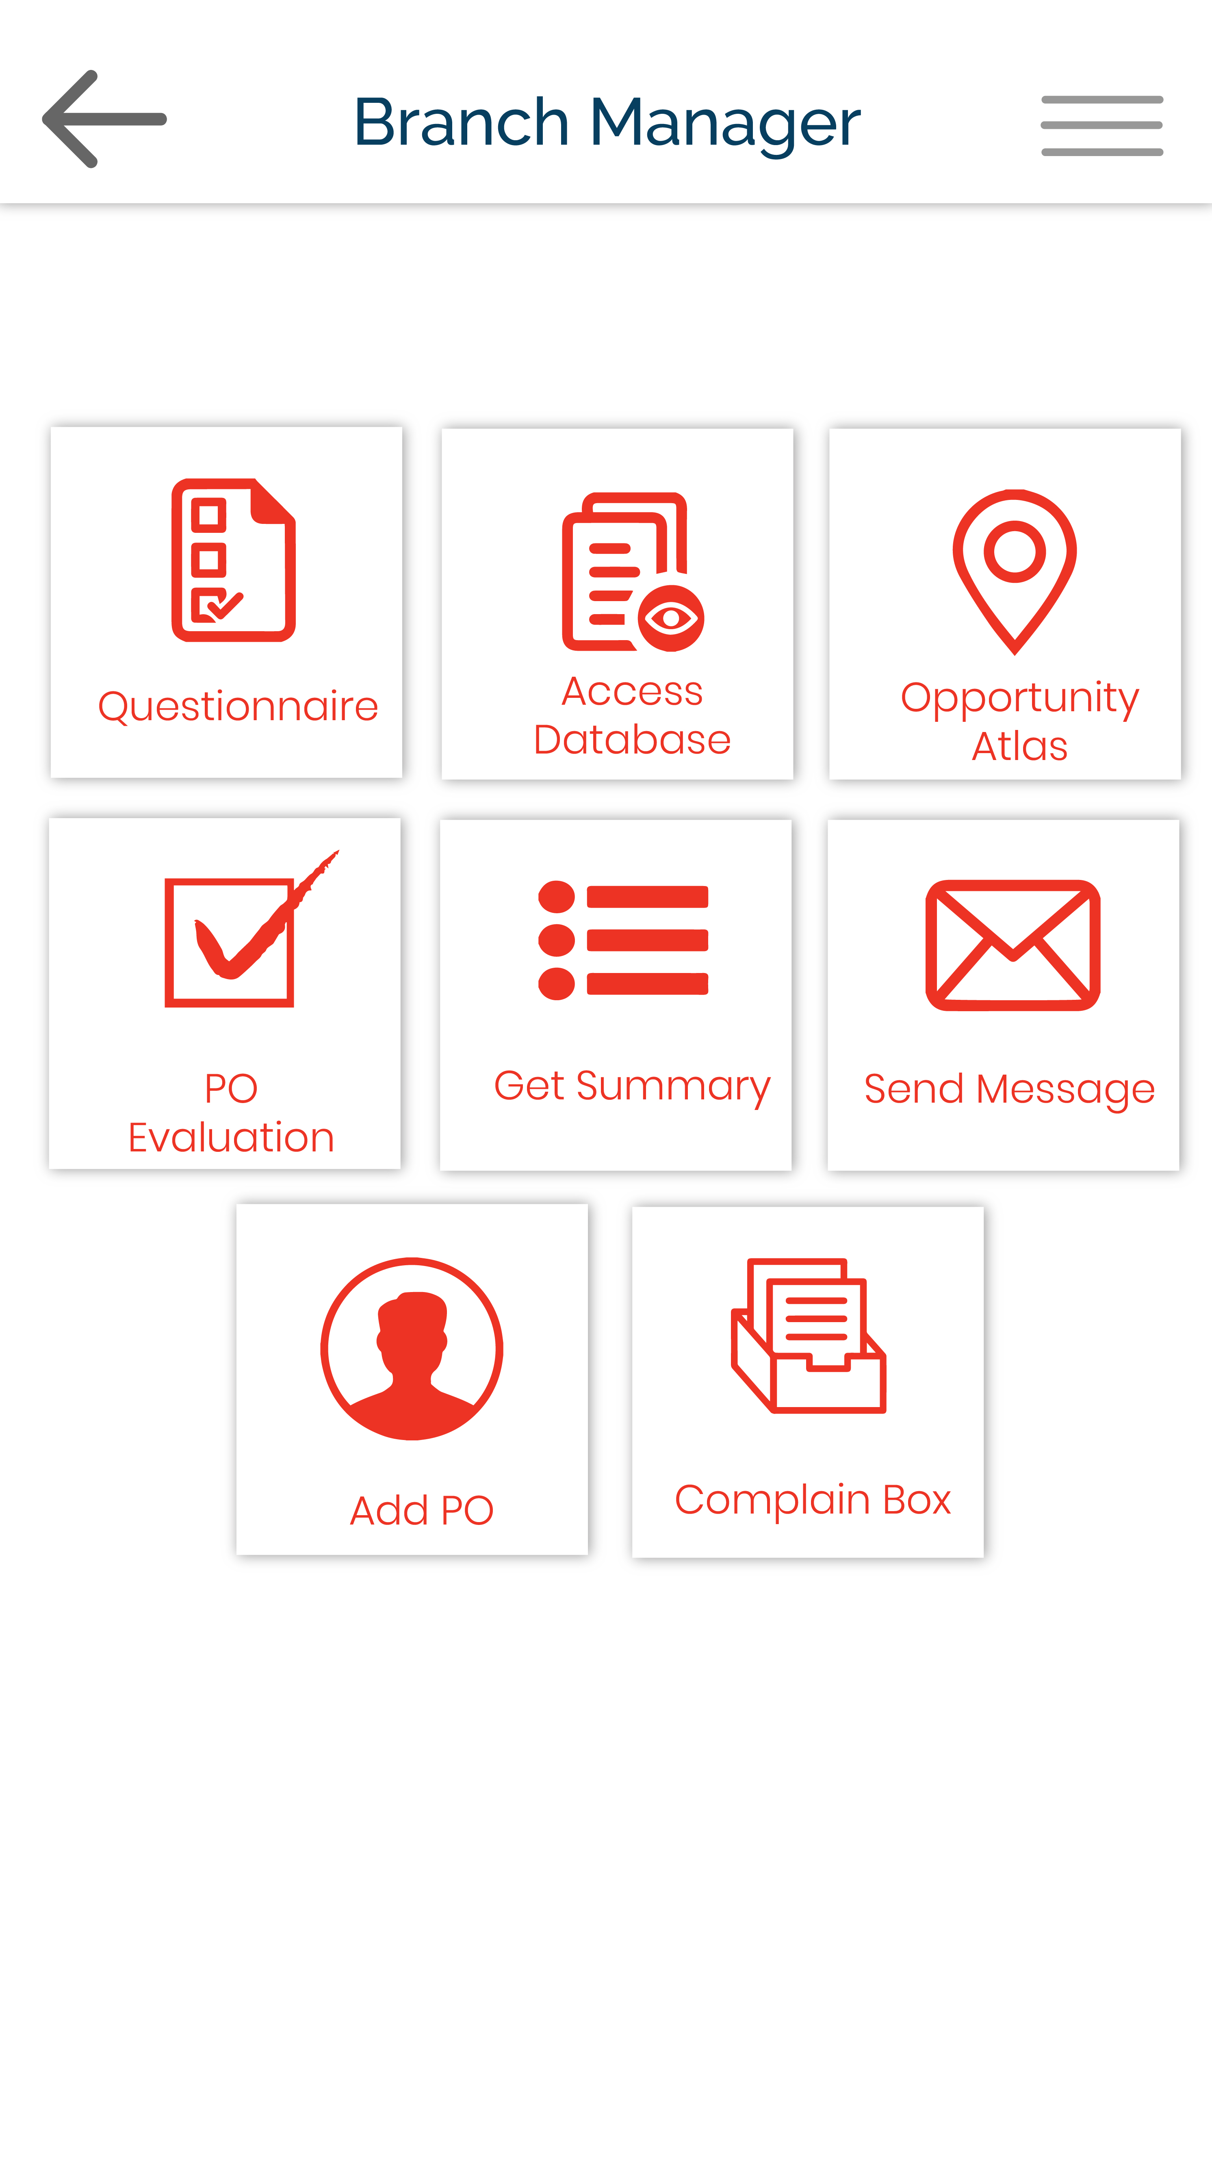
Place your screenshot here
Web Based Real Time Database

Slide 8

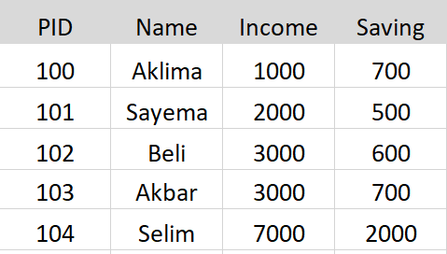
Place your screenshot here
Web Based Real Time Database
Filter

Slide 9
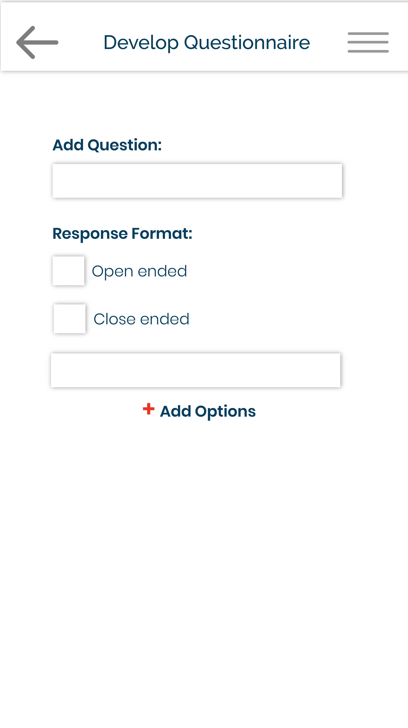
HEAD OFFICE MODE
Place your screenshot here
App based
Questionnaire

Slide 10
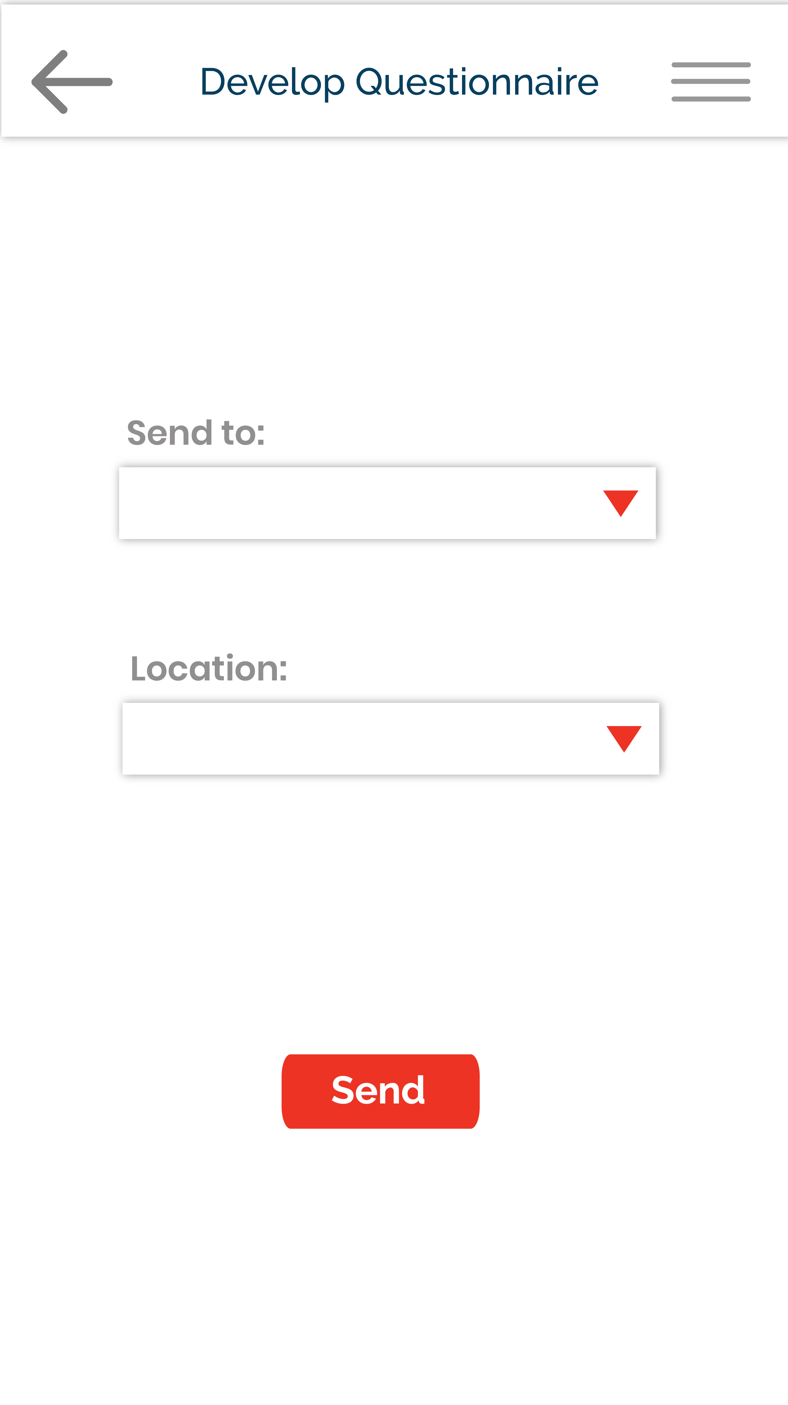
HEAD OFFICE MODE
Place your screenshot here
App based
Questionnaire

Slide 11
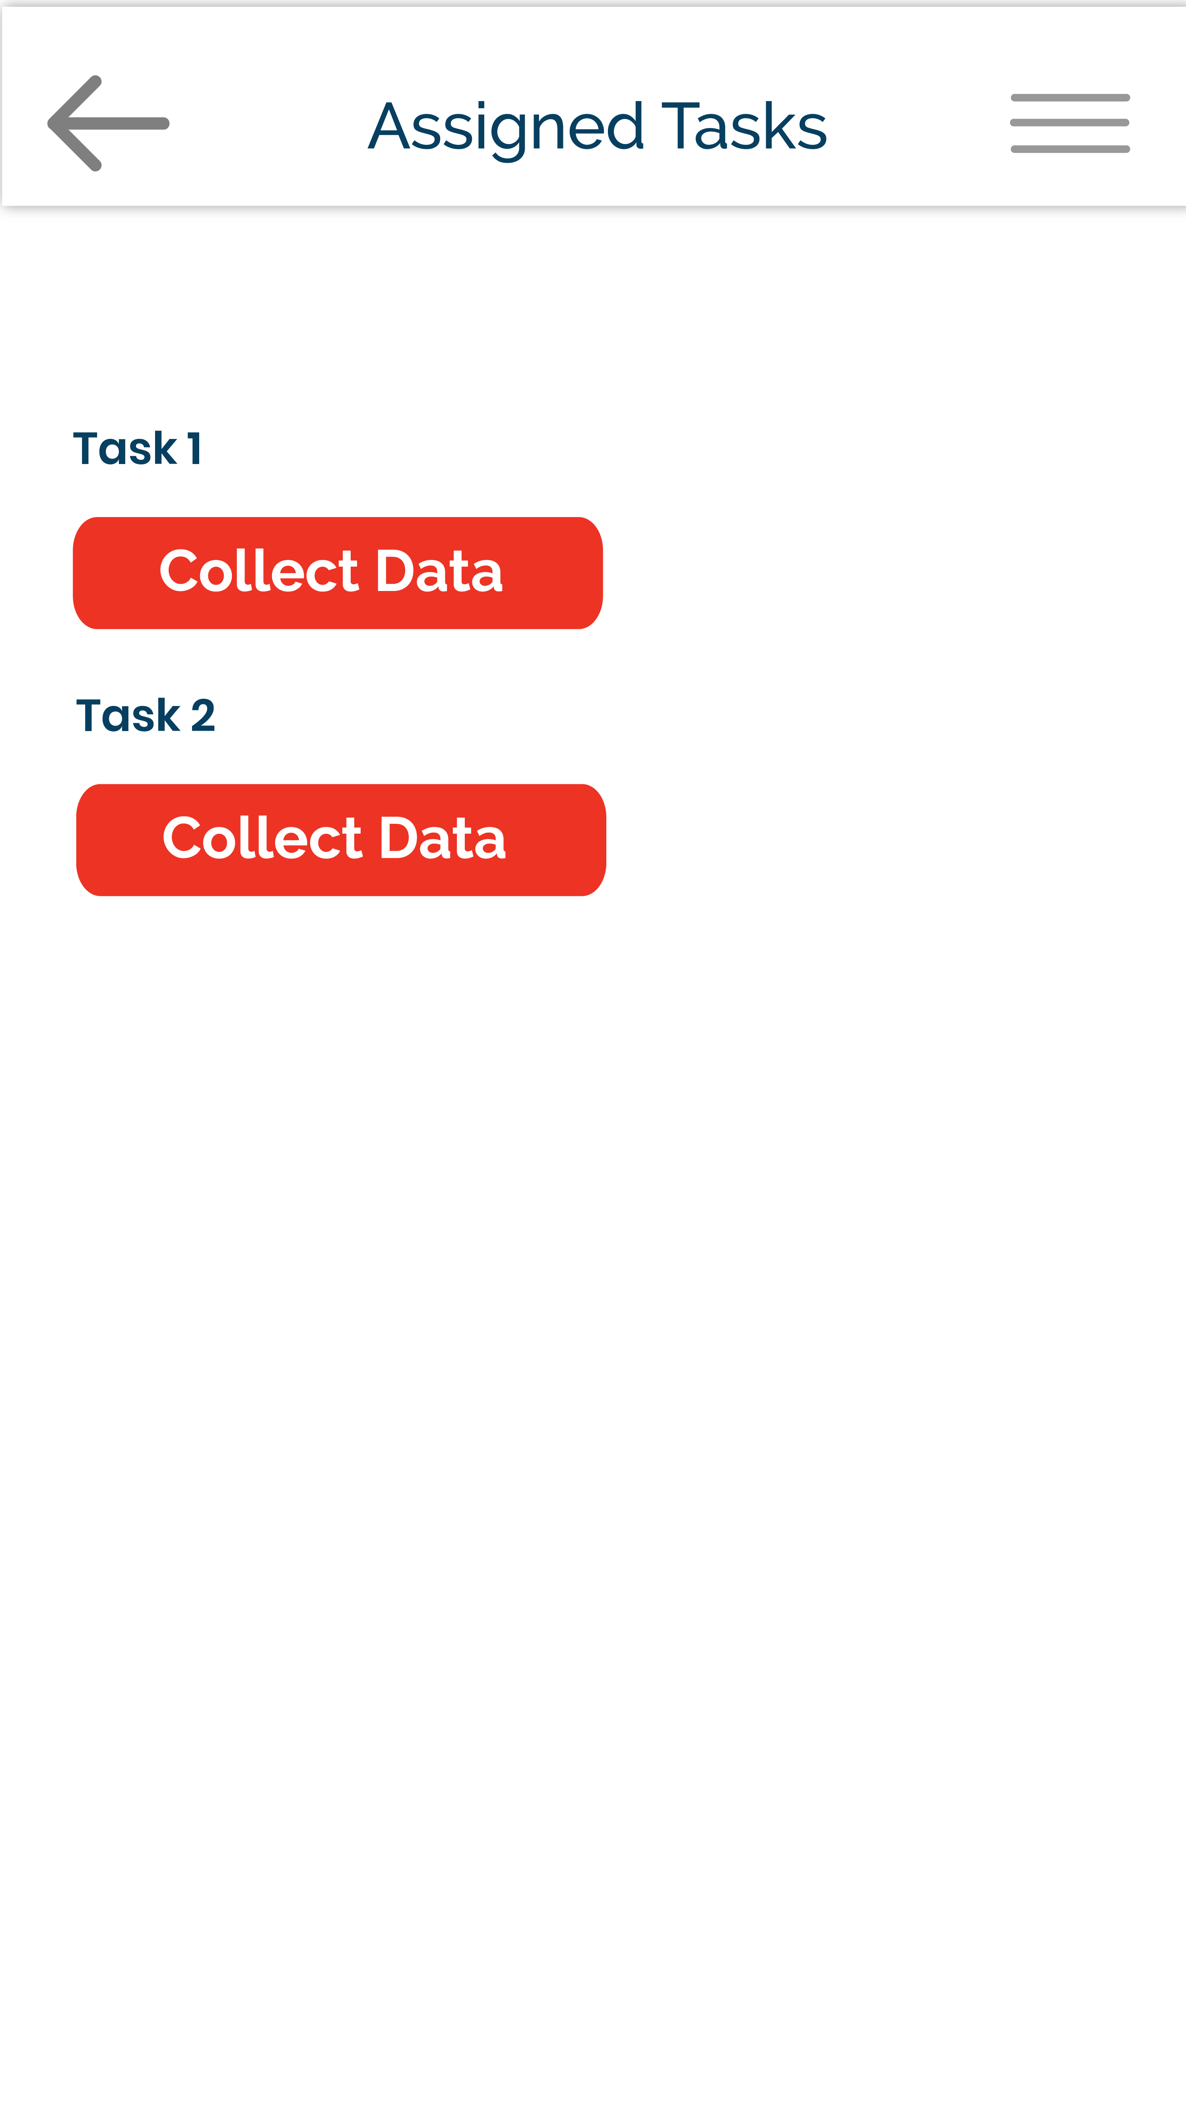
PO MODE
Place your screenshot here
App based
Questionnaire

Slide 12
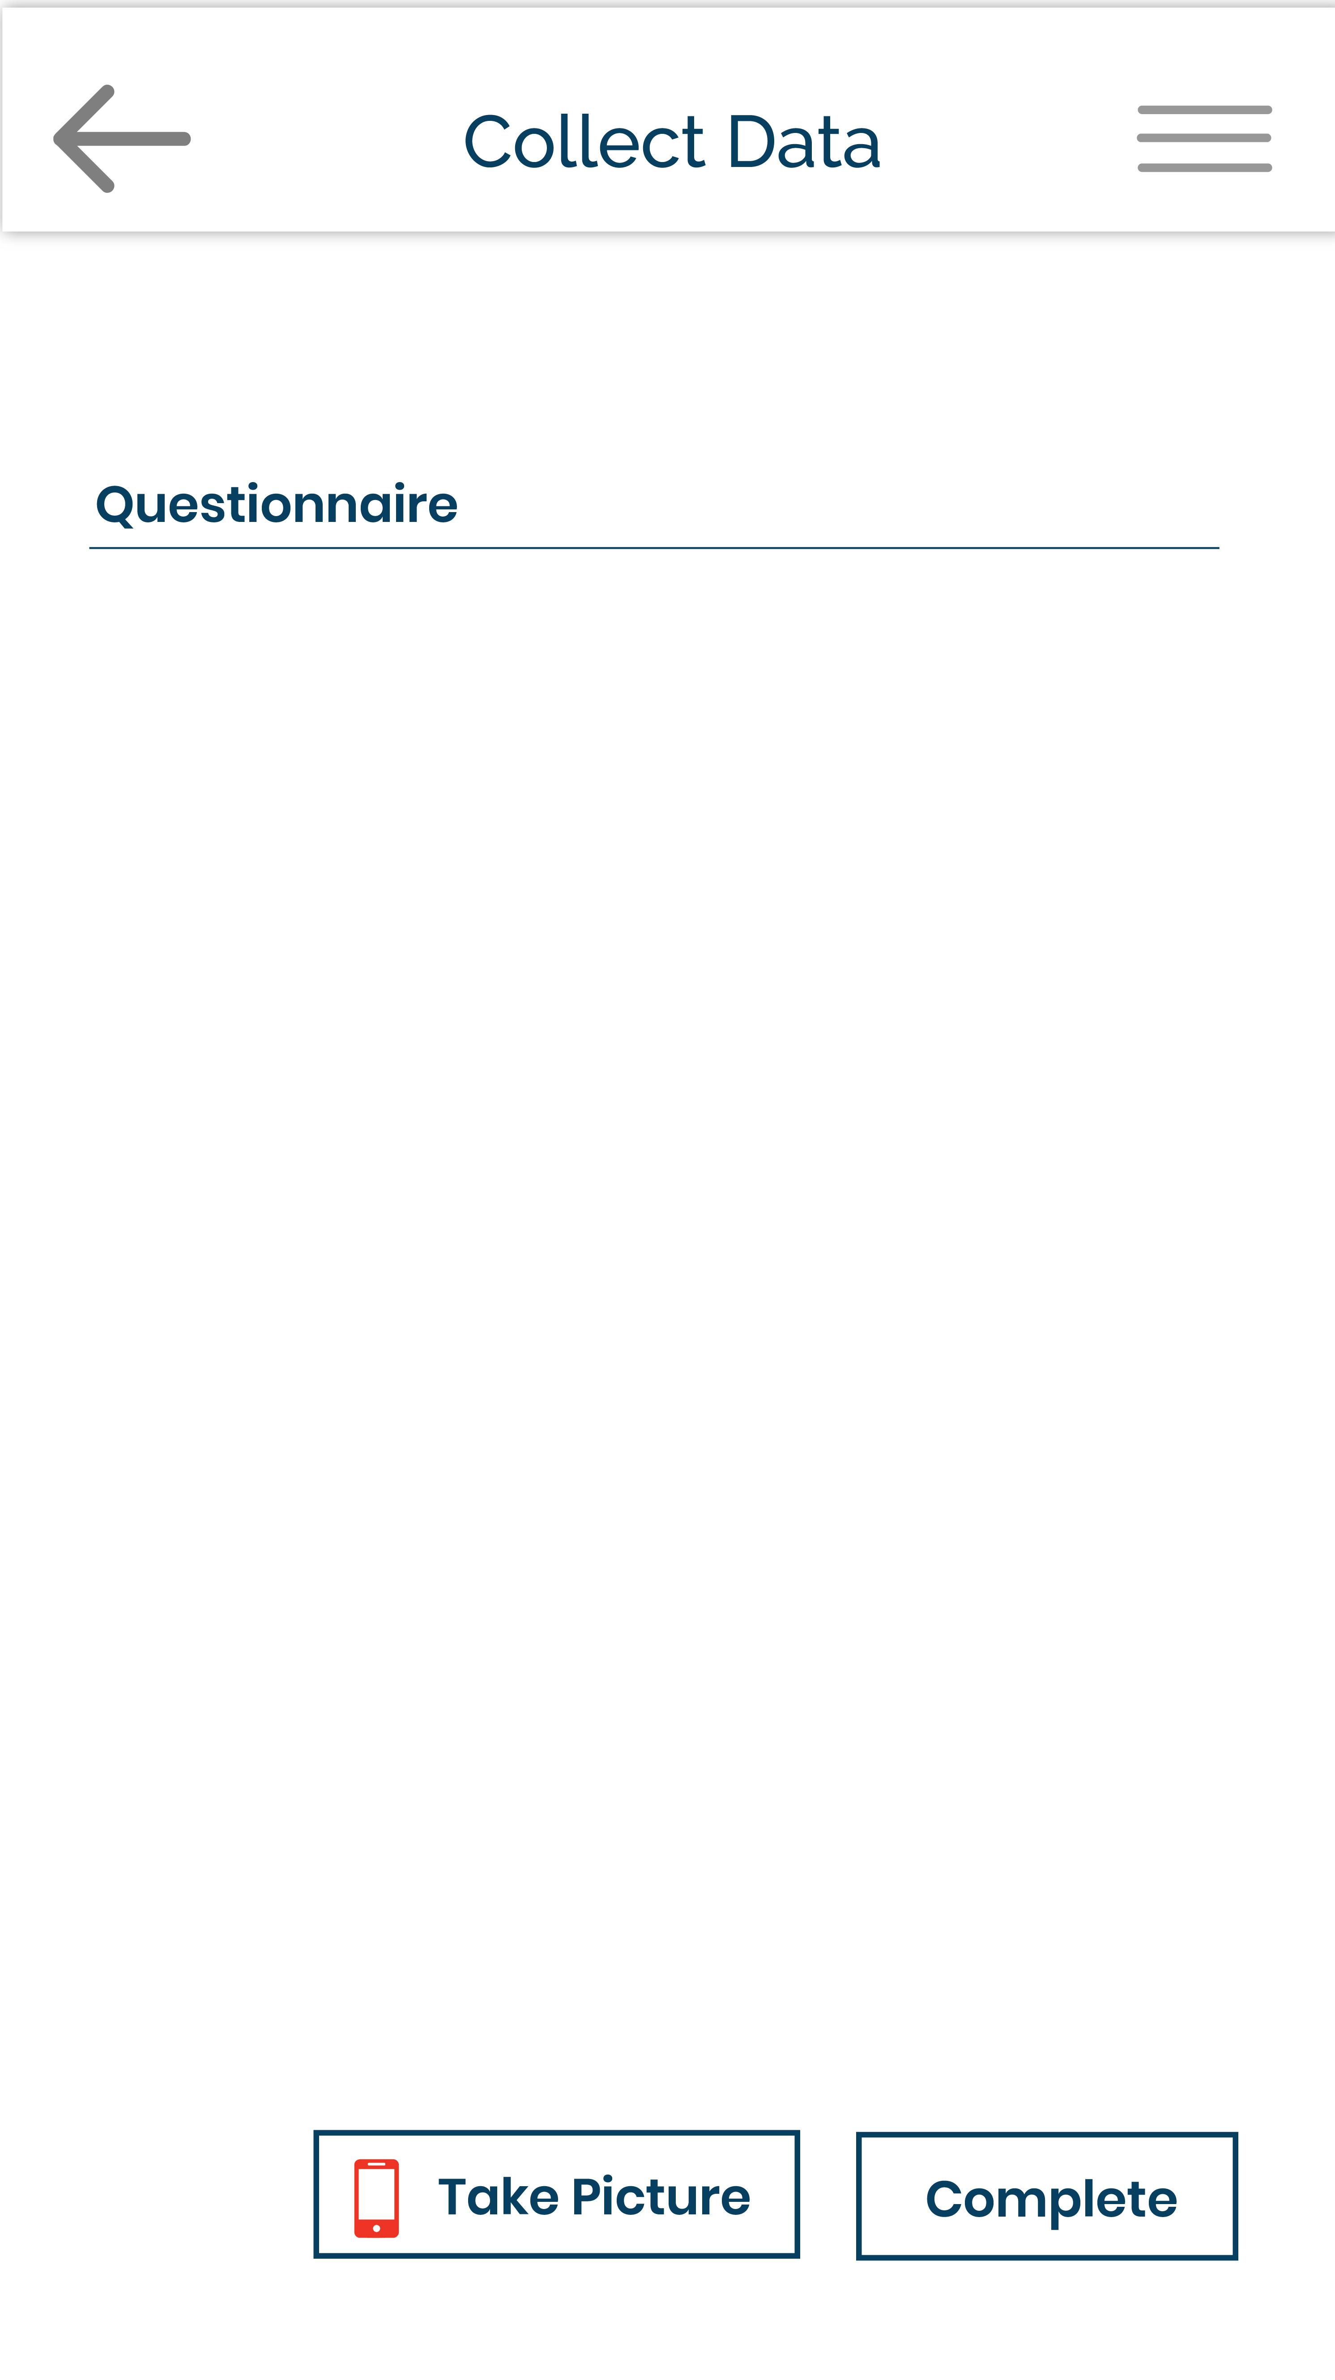
PO MODE
Place your screenshot here
App based
Questionnaire

Slide 13
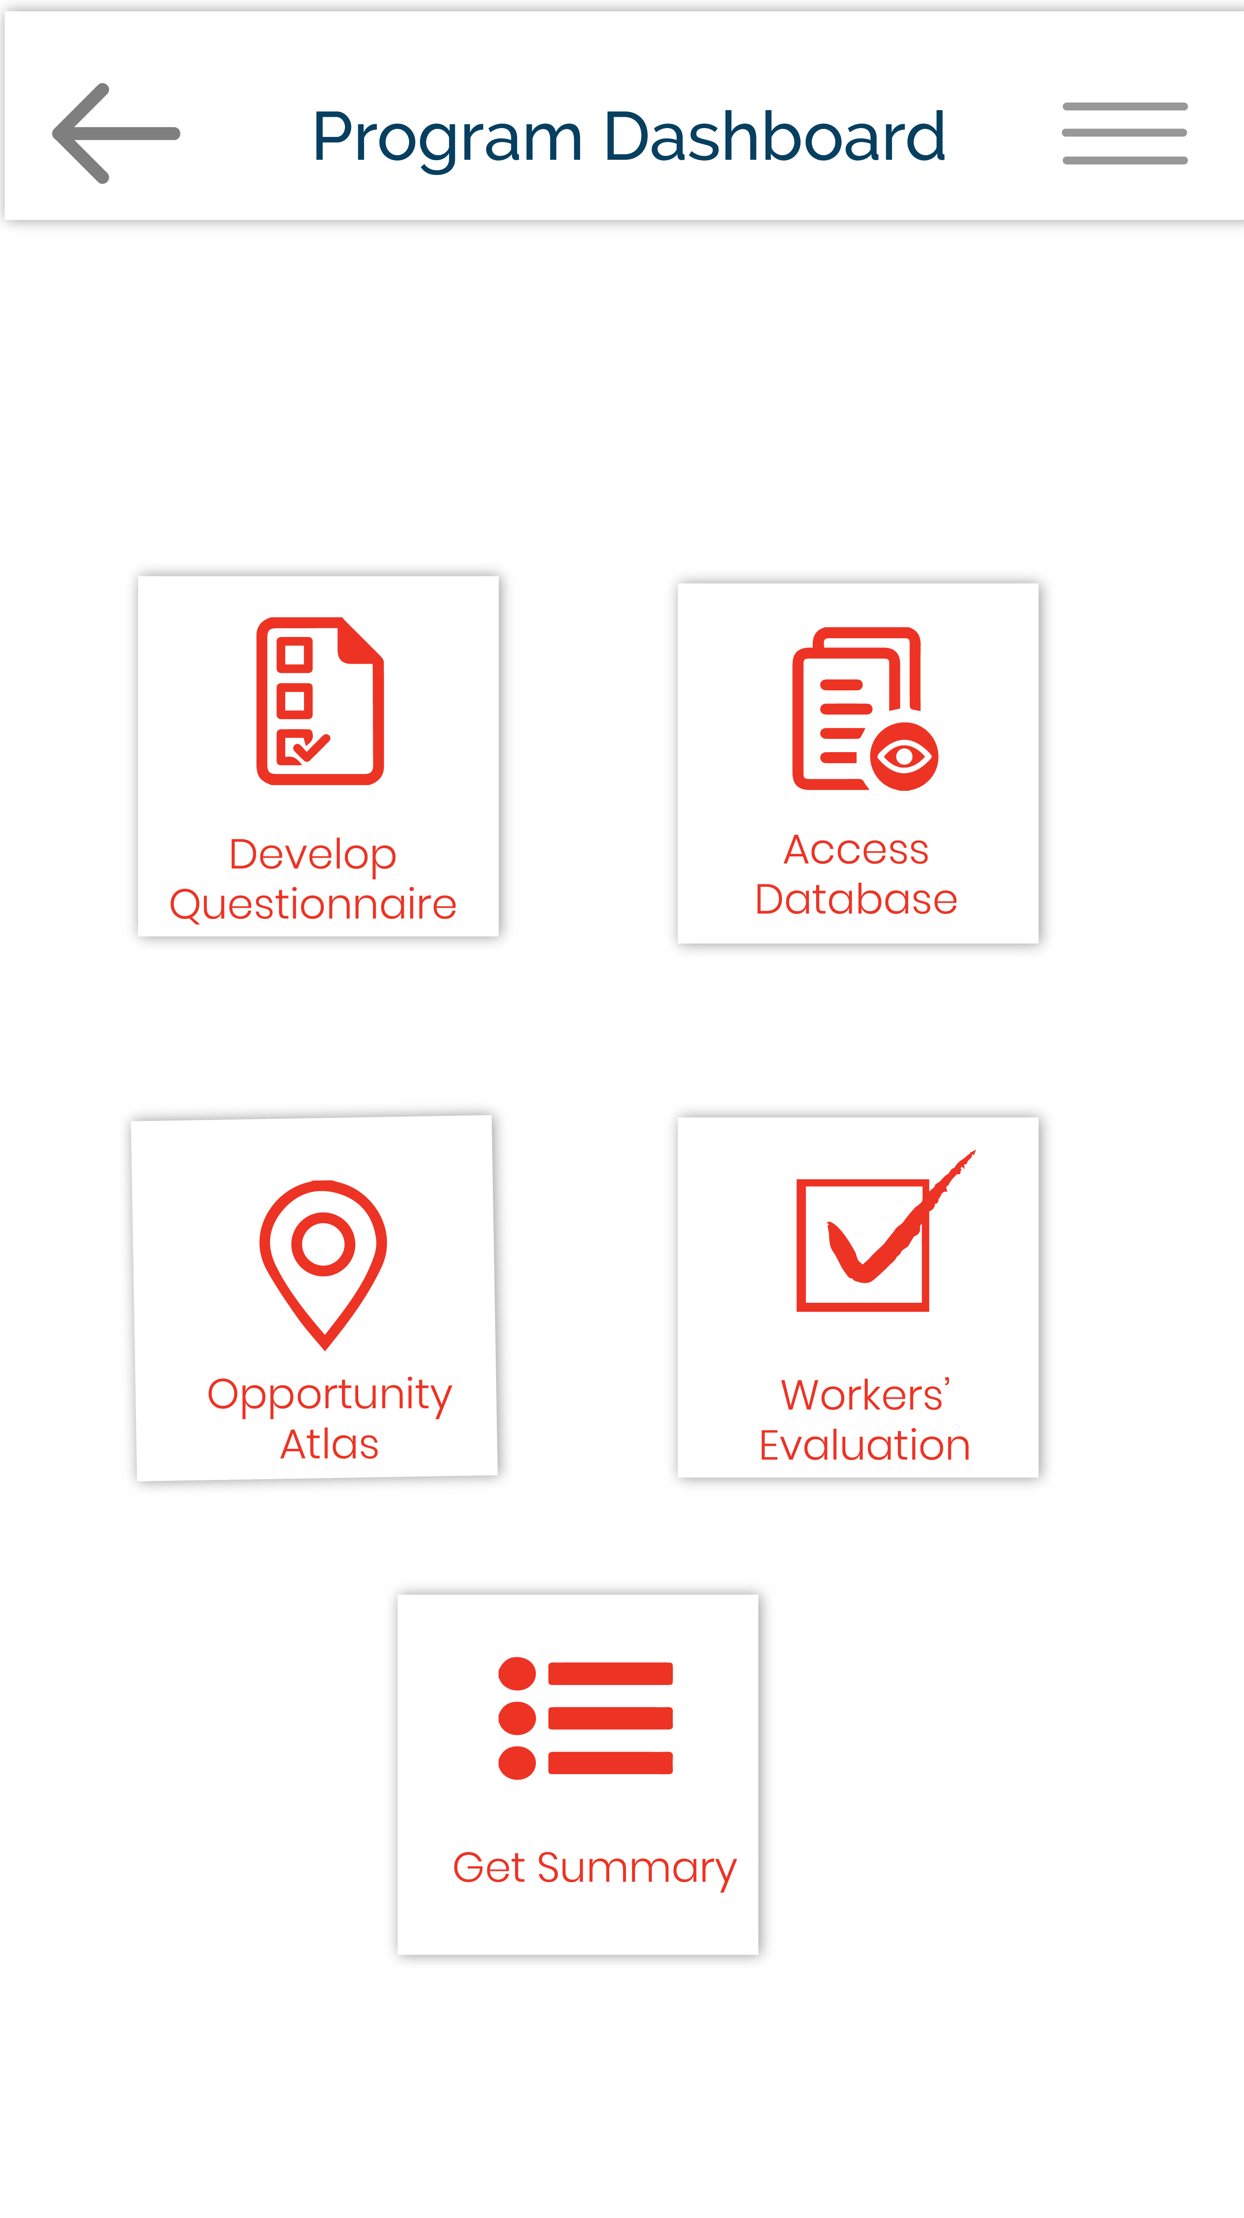
Place your screenshot here
Analyze

Slide 14
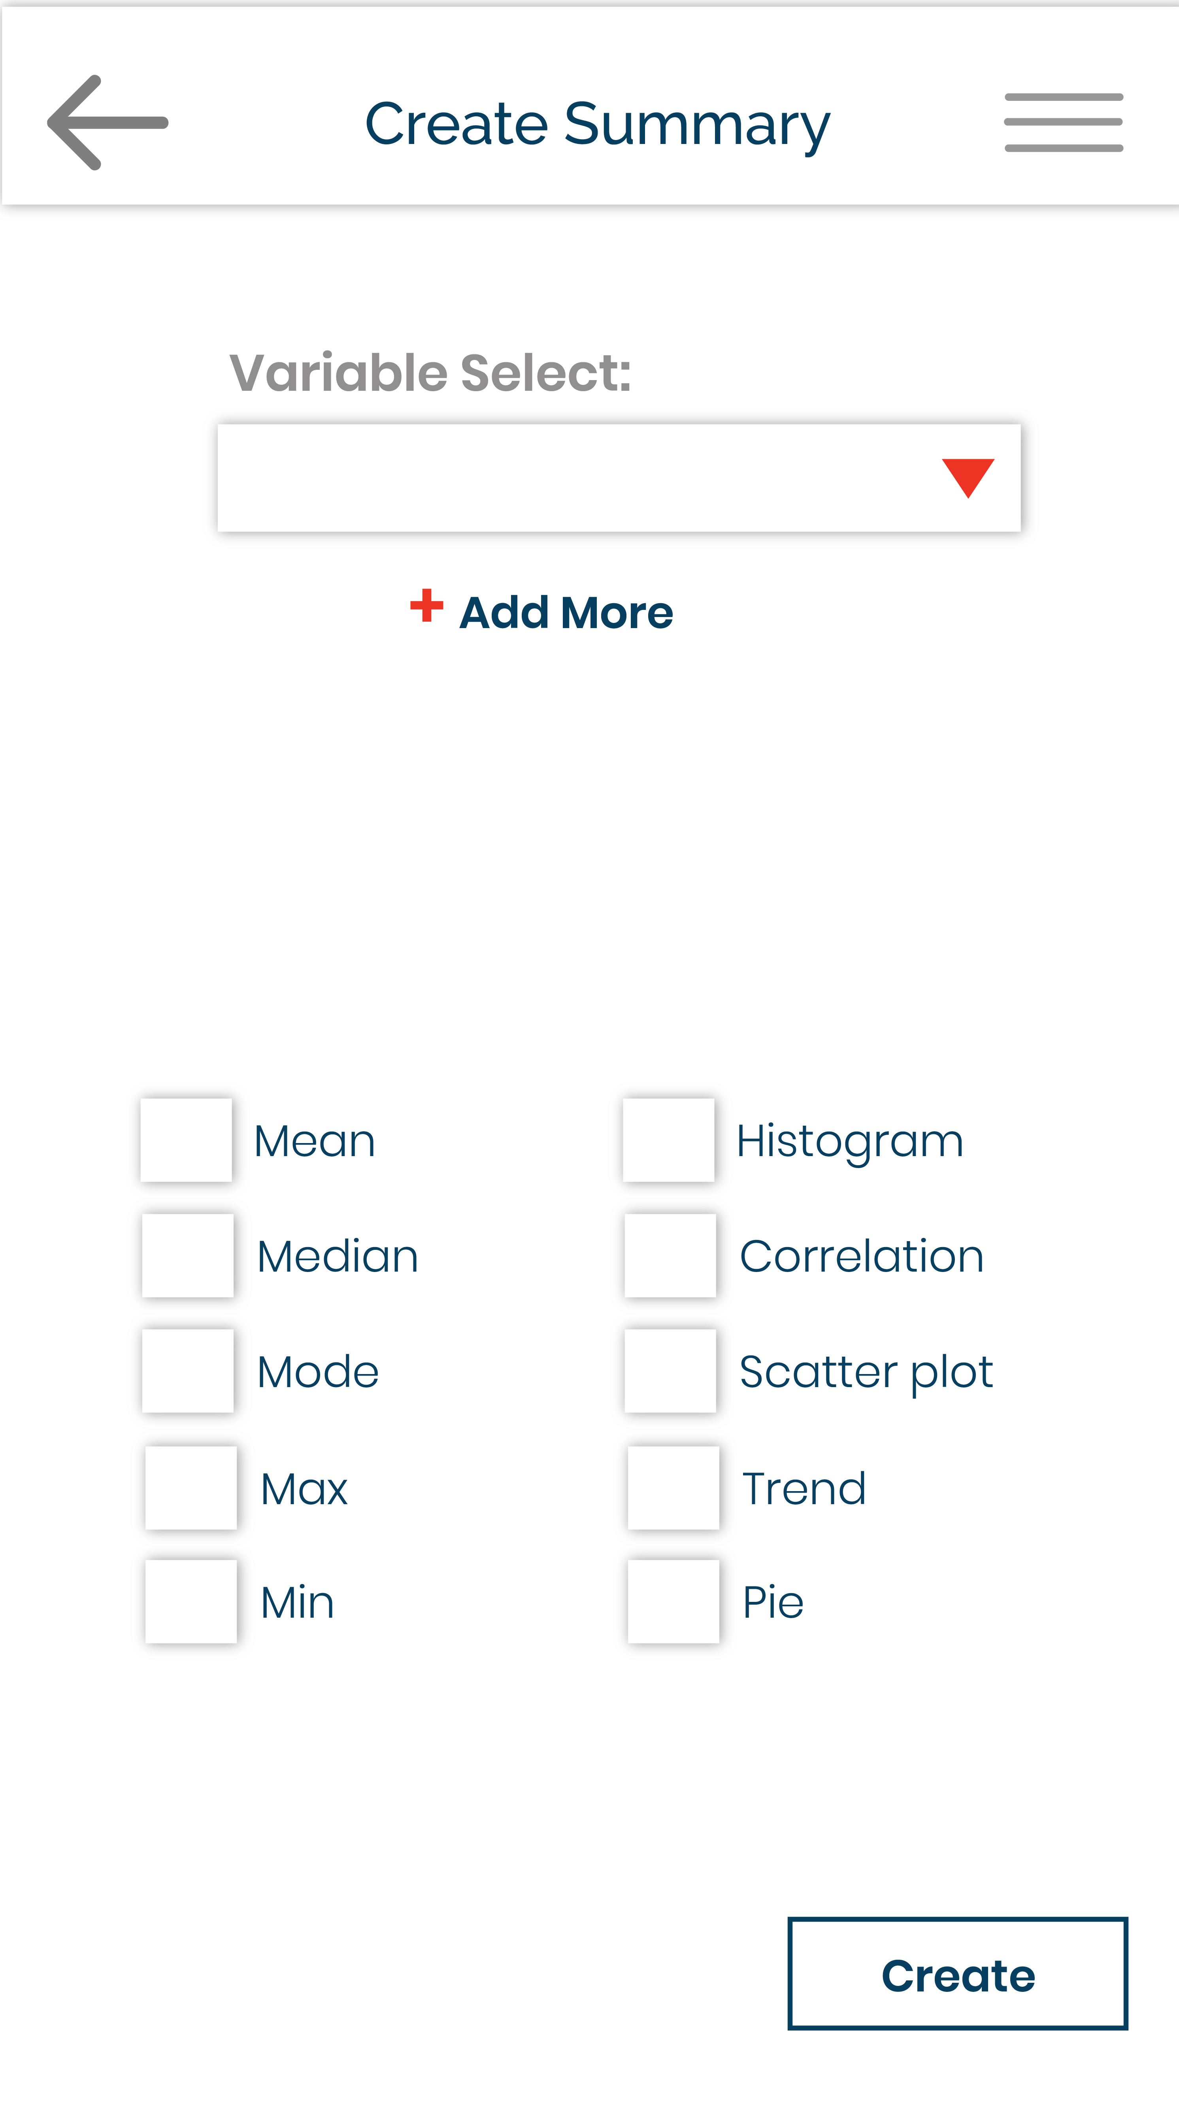
Place your screenshot here
Analyze

Slide 15
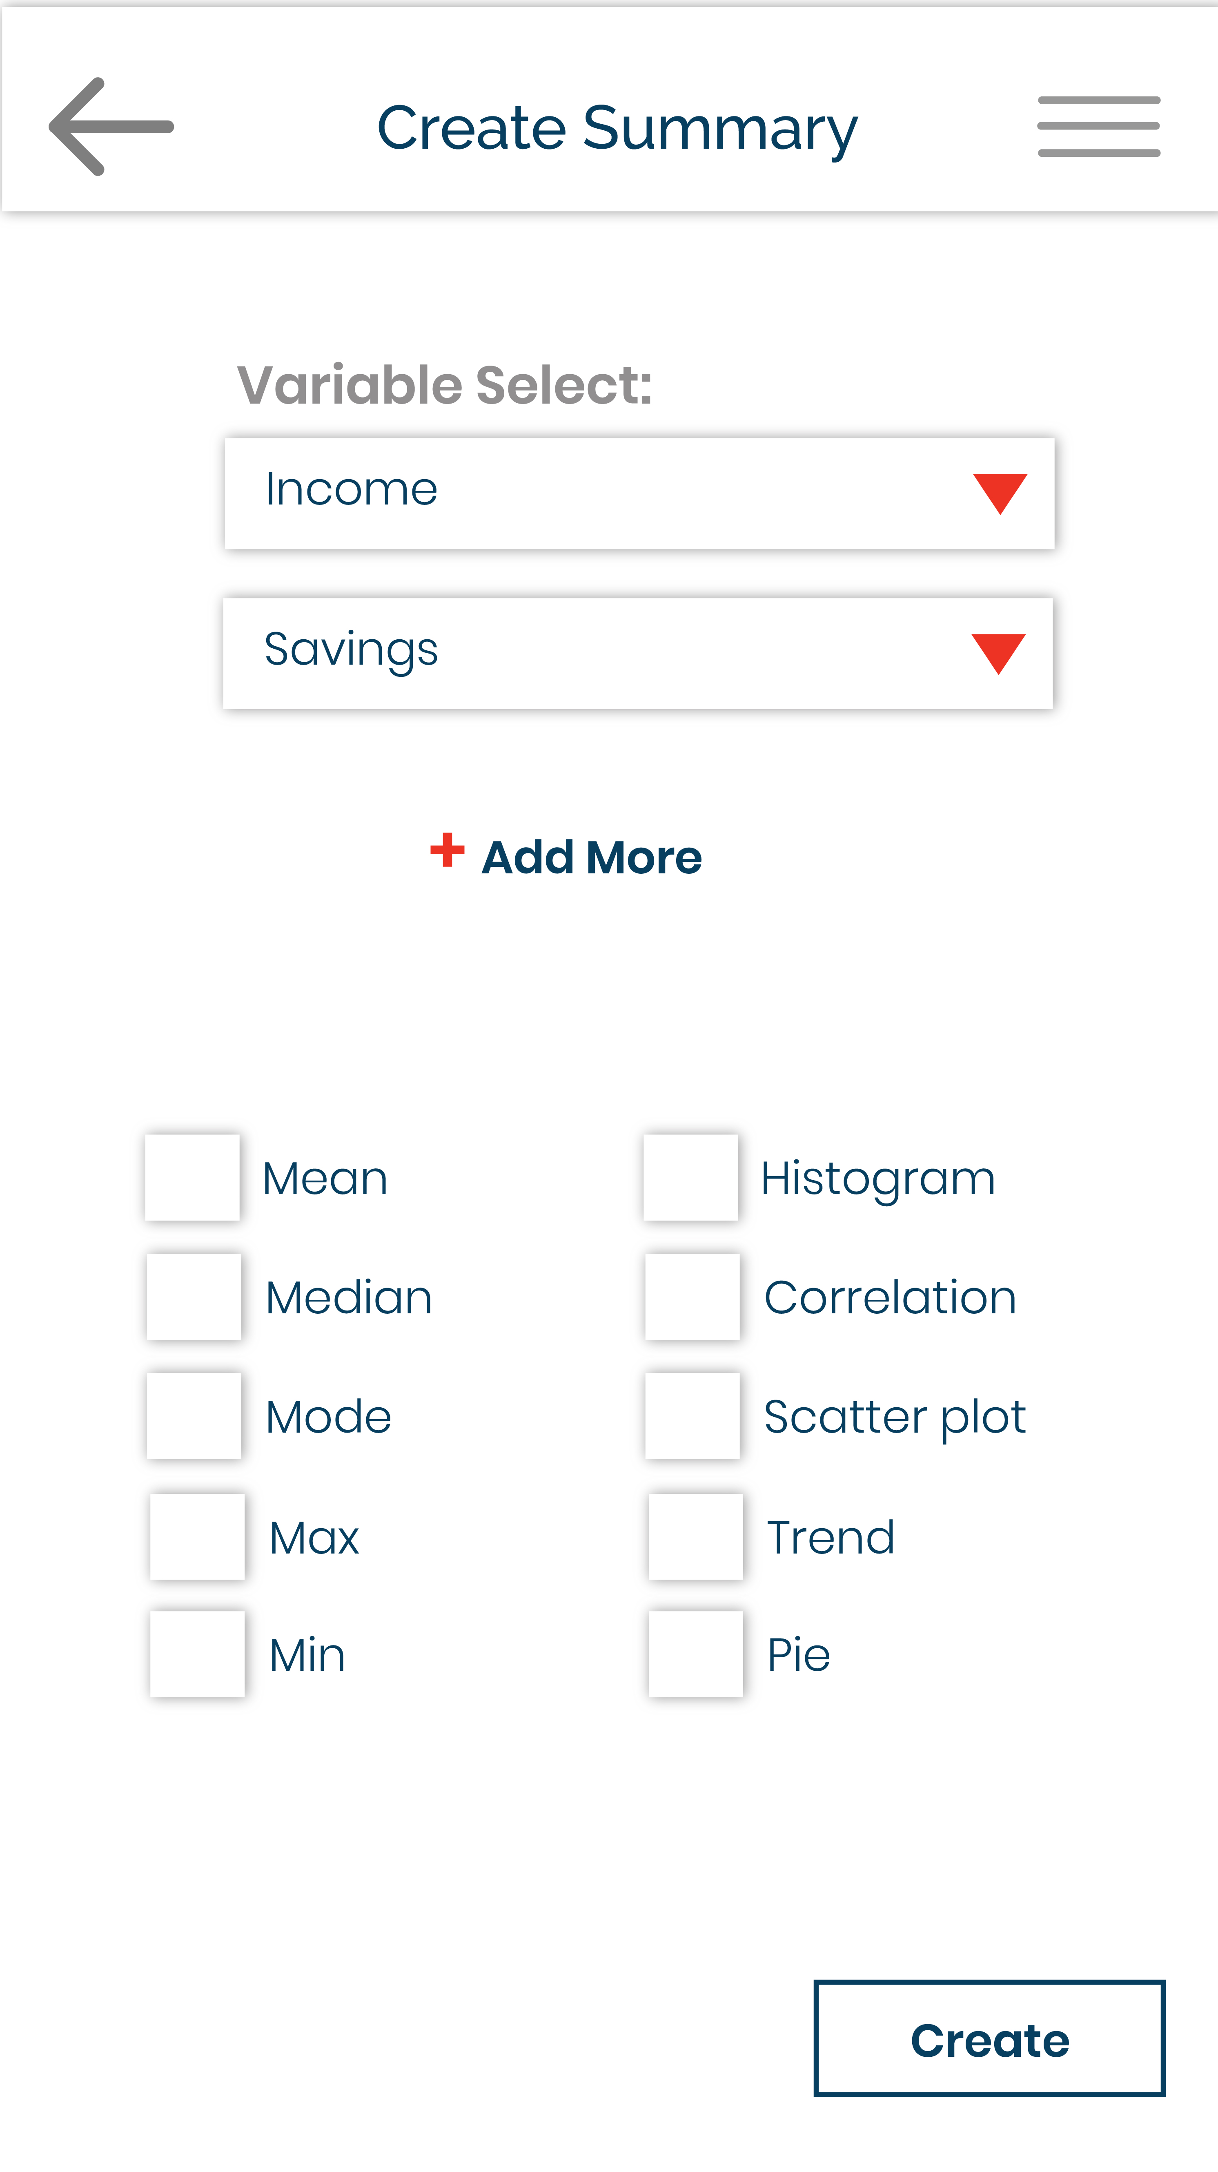
Place your screenshot here
Analyze

Slide 16
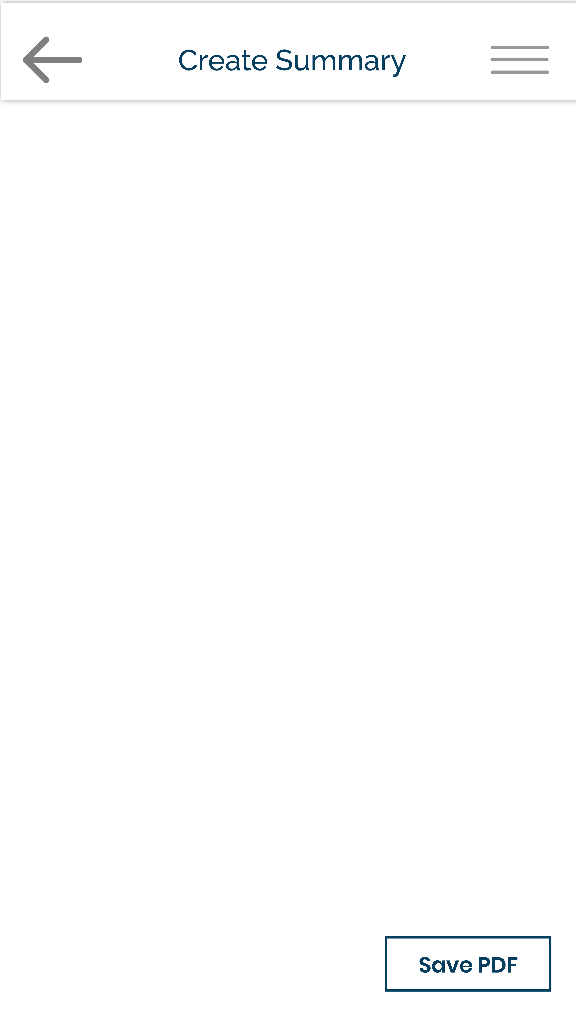
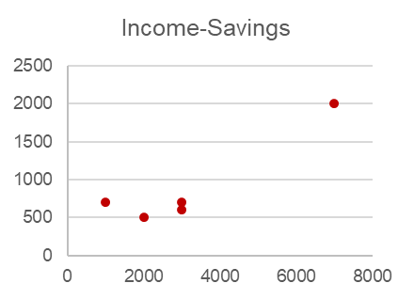
Place your screenshot here
 | Income | Saving
Mean | 3200 | 900
Analyze
Correlation: 0.91878

Slide 17
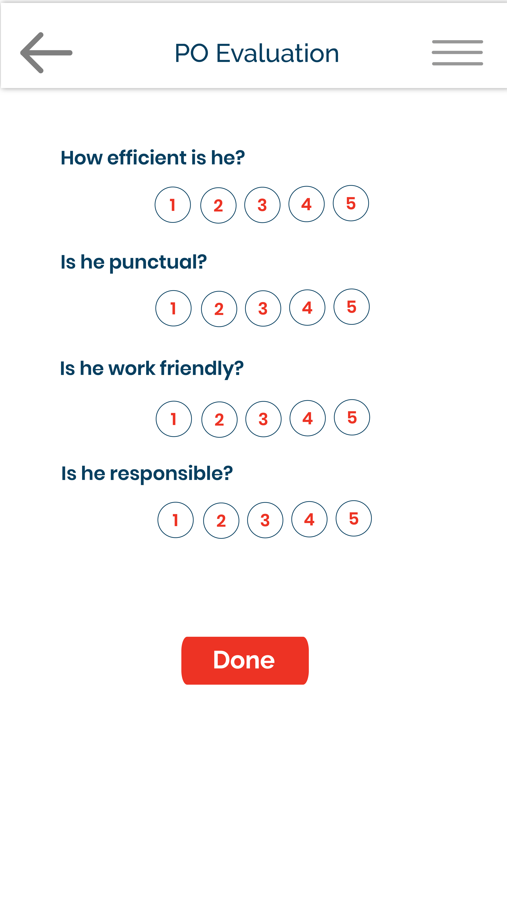
BM MODE
Place your screenshot here
Sophisticated Evaluation System

Slide 18
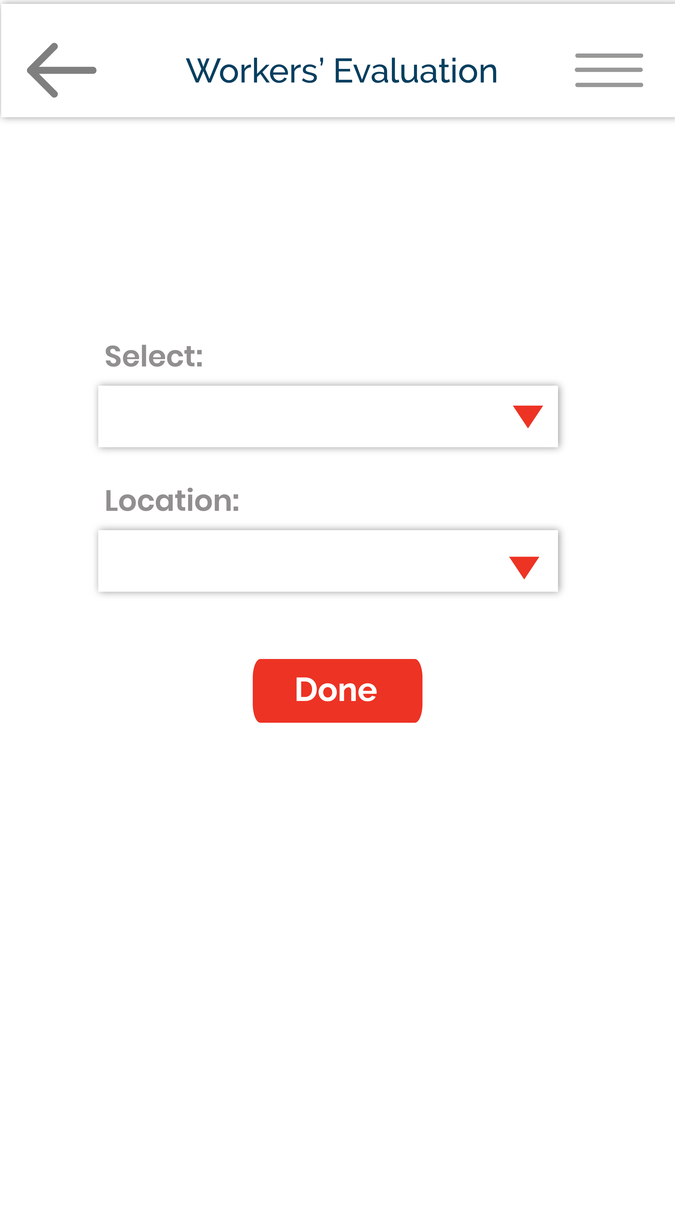
HEAD OFFICE MODE
Place your screenshot here
Sophisticated Evaluation System

Slide 19
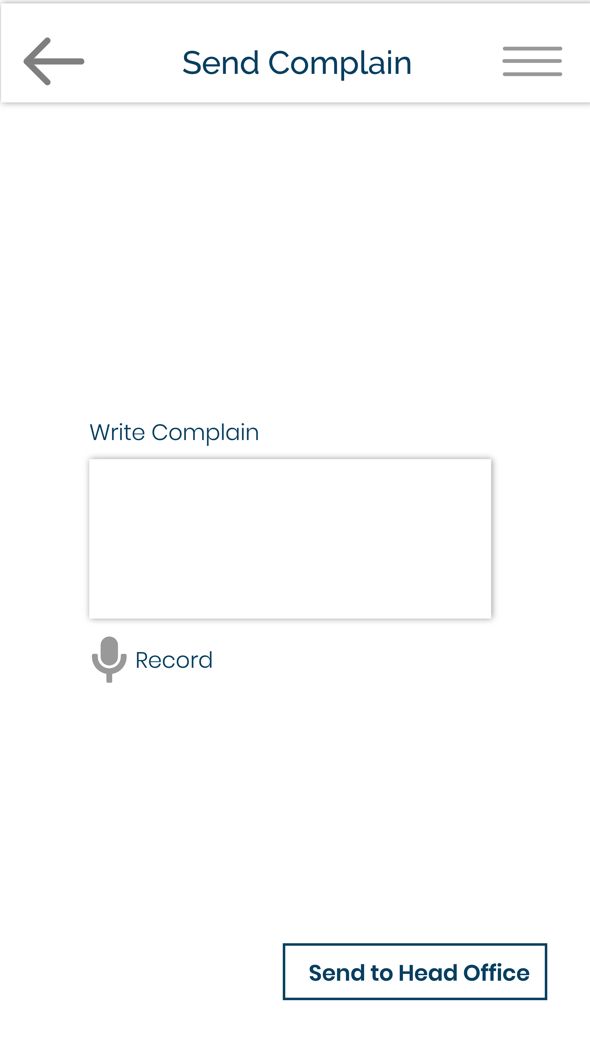
ZM/RM/BM/PO MODE
Place your screenshot here
Easy Information Flow

Slide 20

HEAD OFFICE
MODE
Place your screenshot here
Easy Information Flow

Slide 21
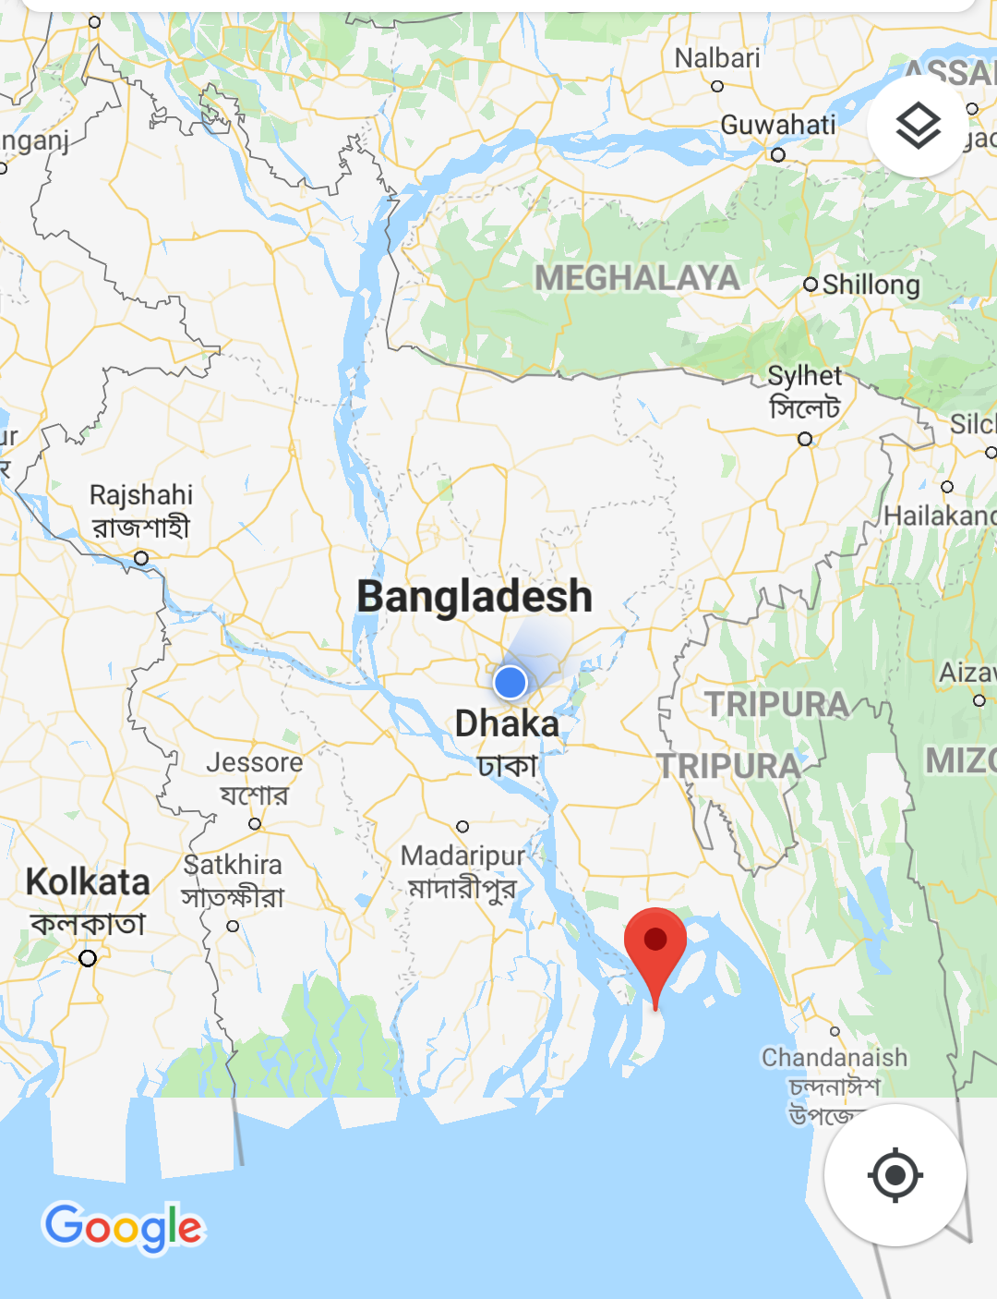

Slide 22
Let’s Materialize our dream of
Green Bangladesh

Slide 23
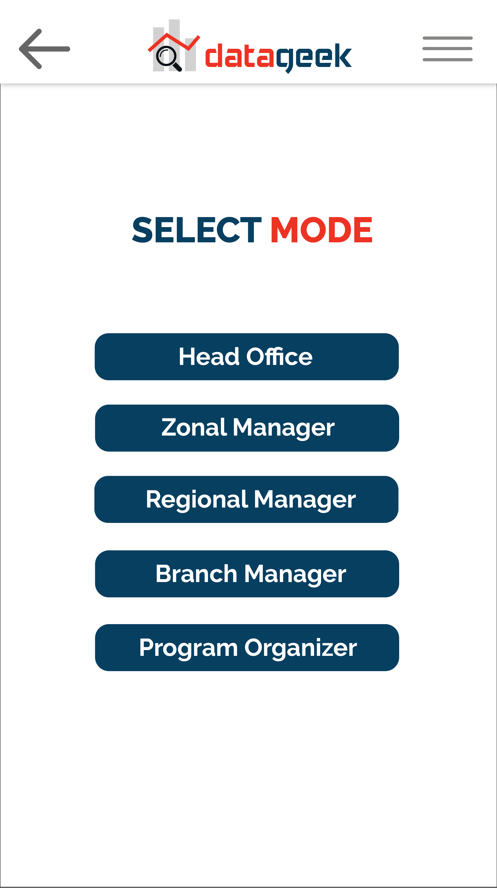
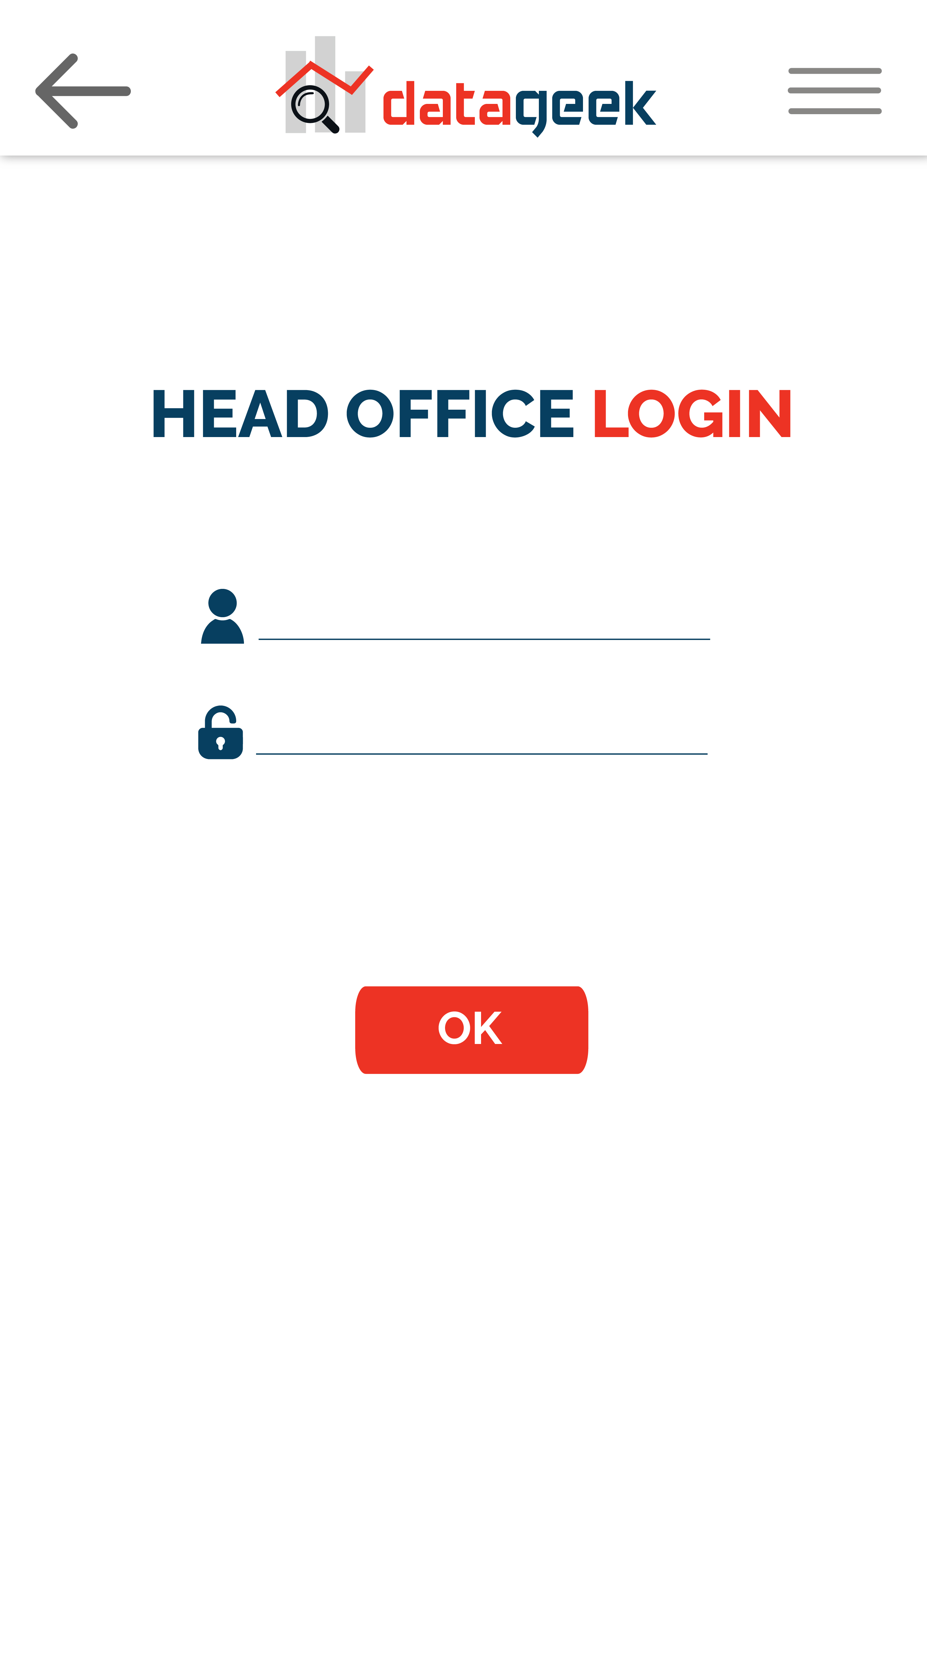
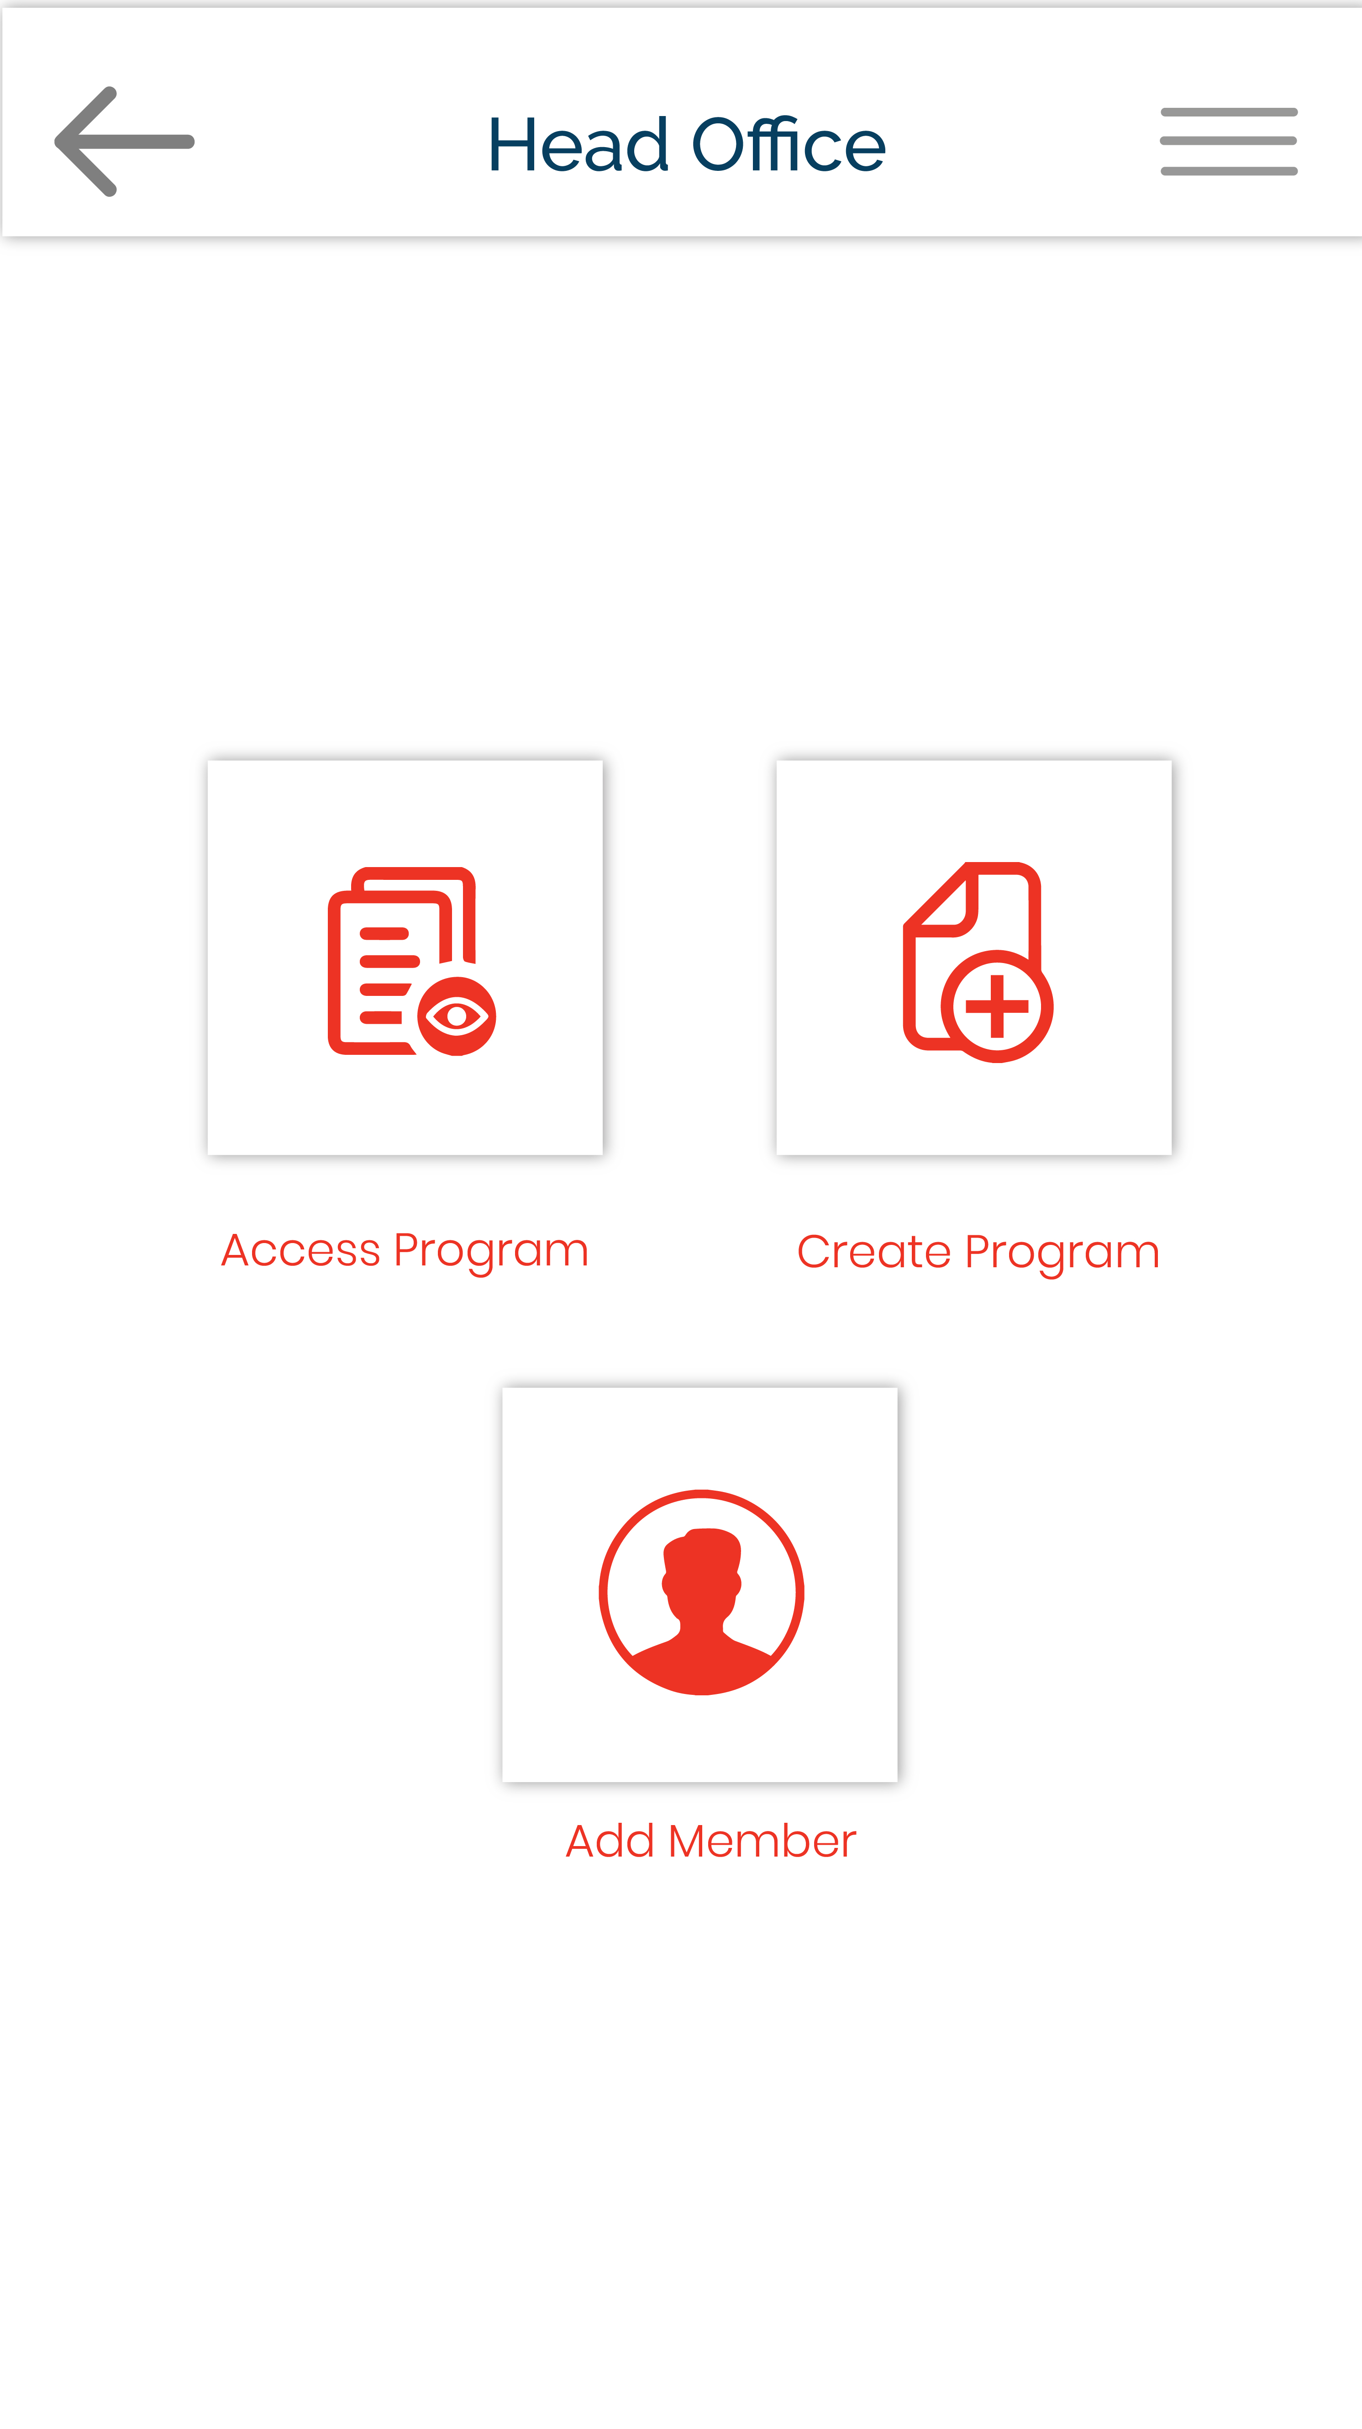
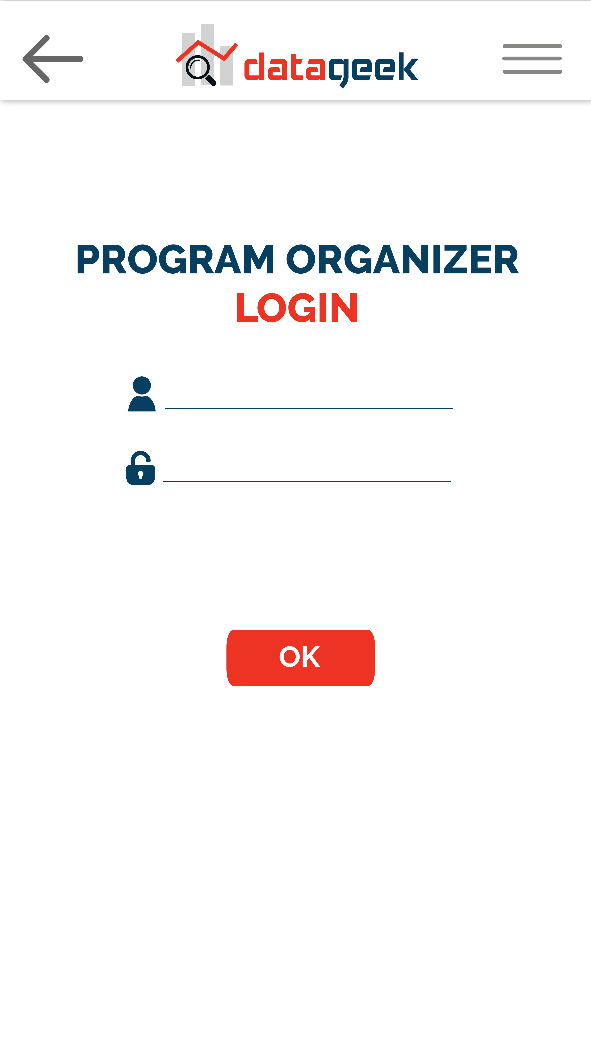


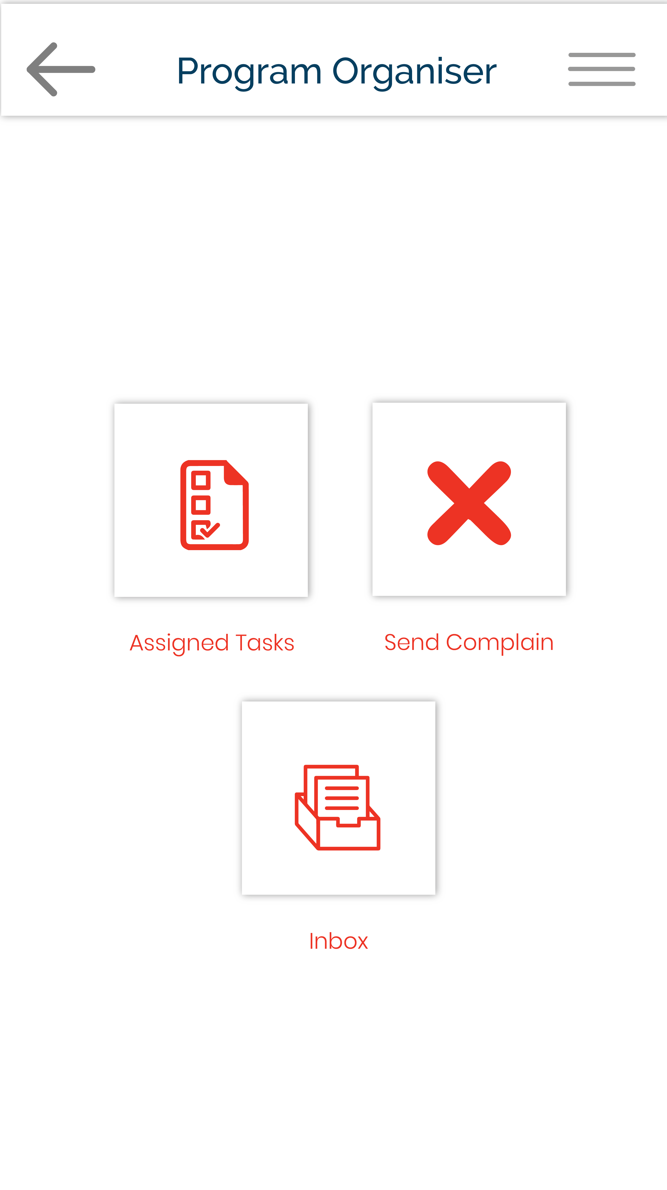

Slide 24
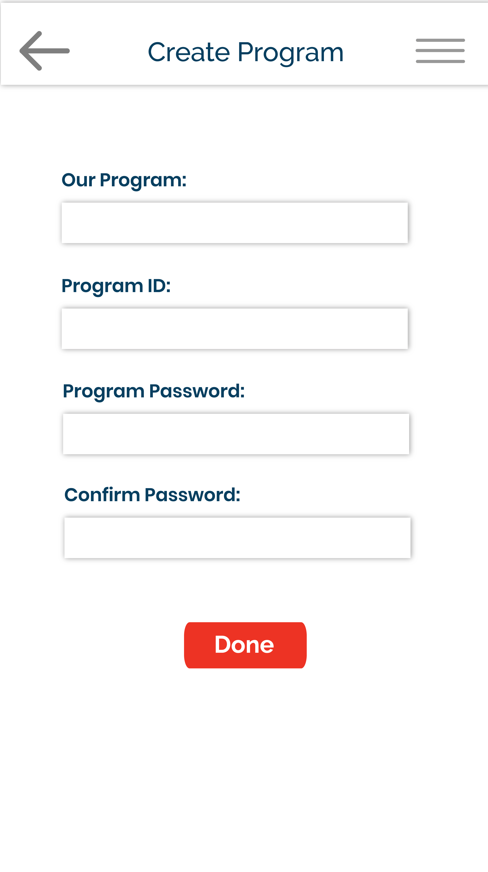
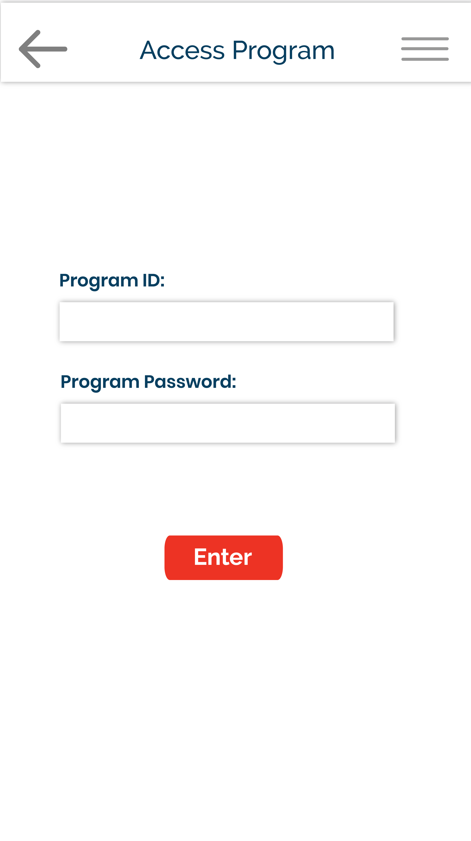
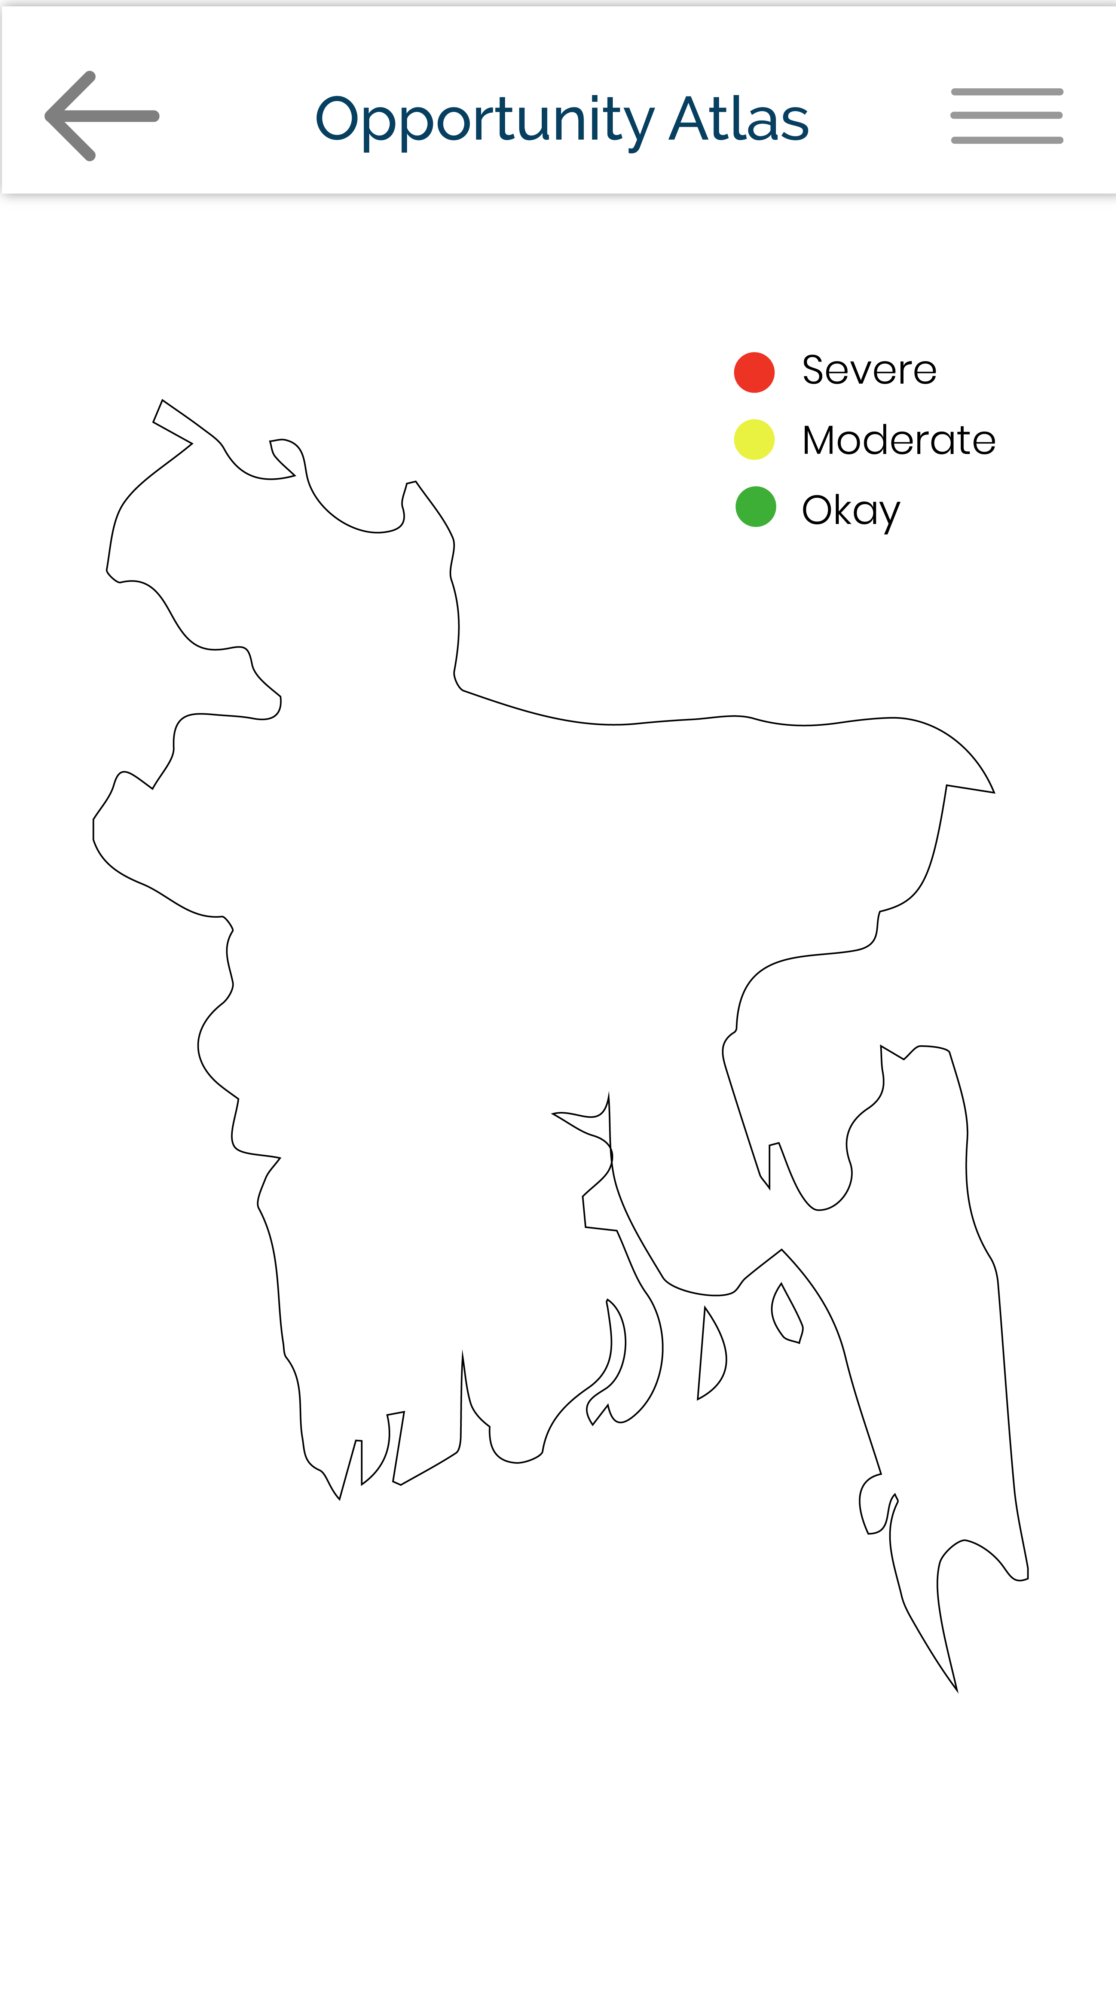

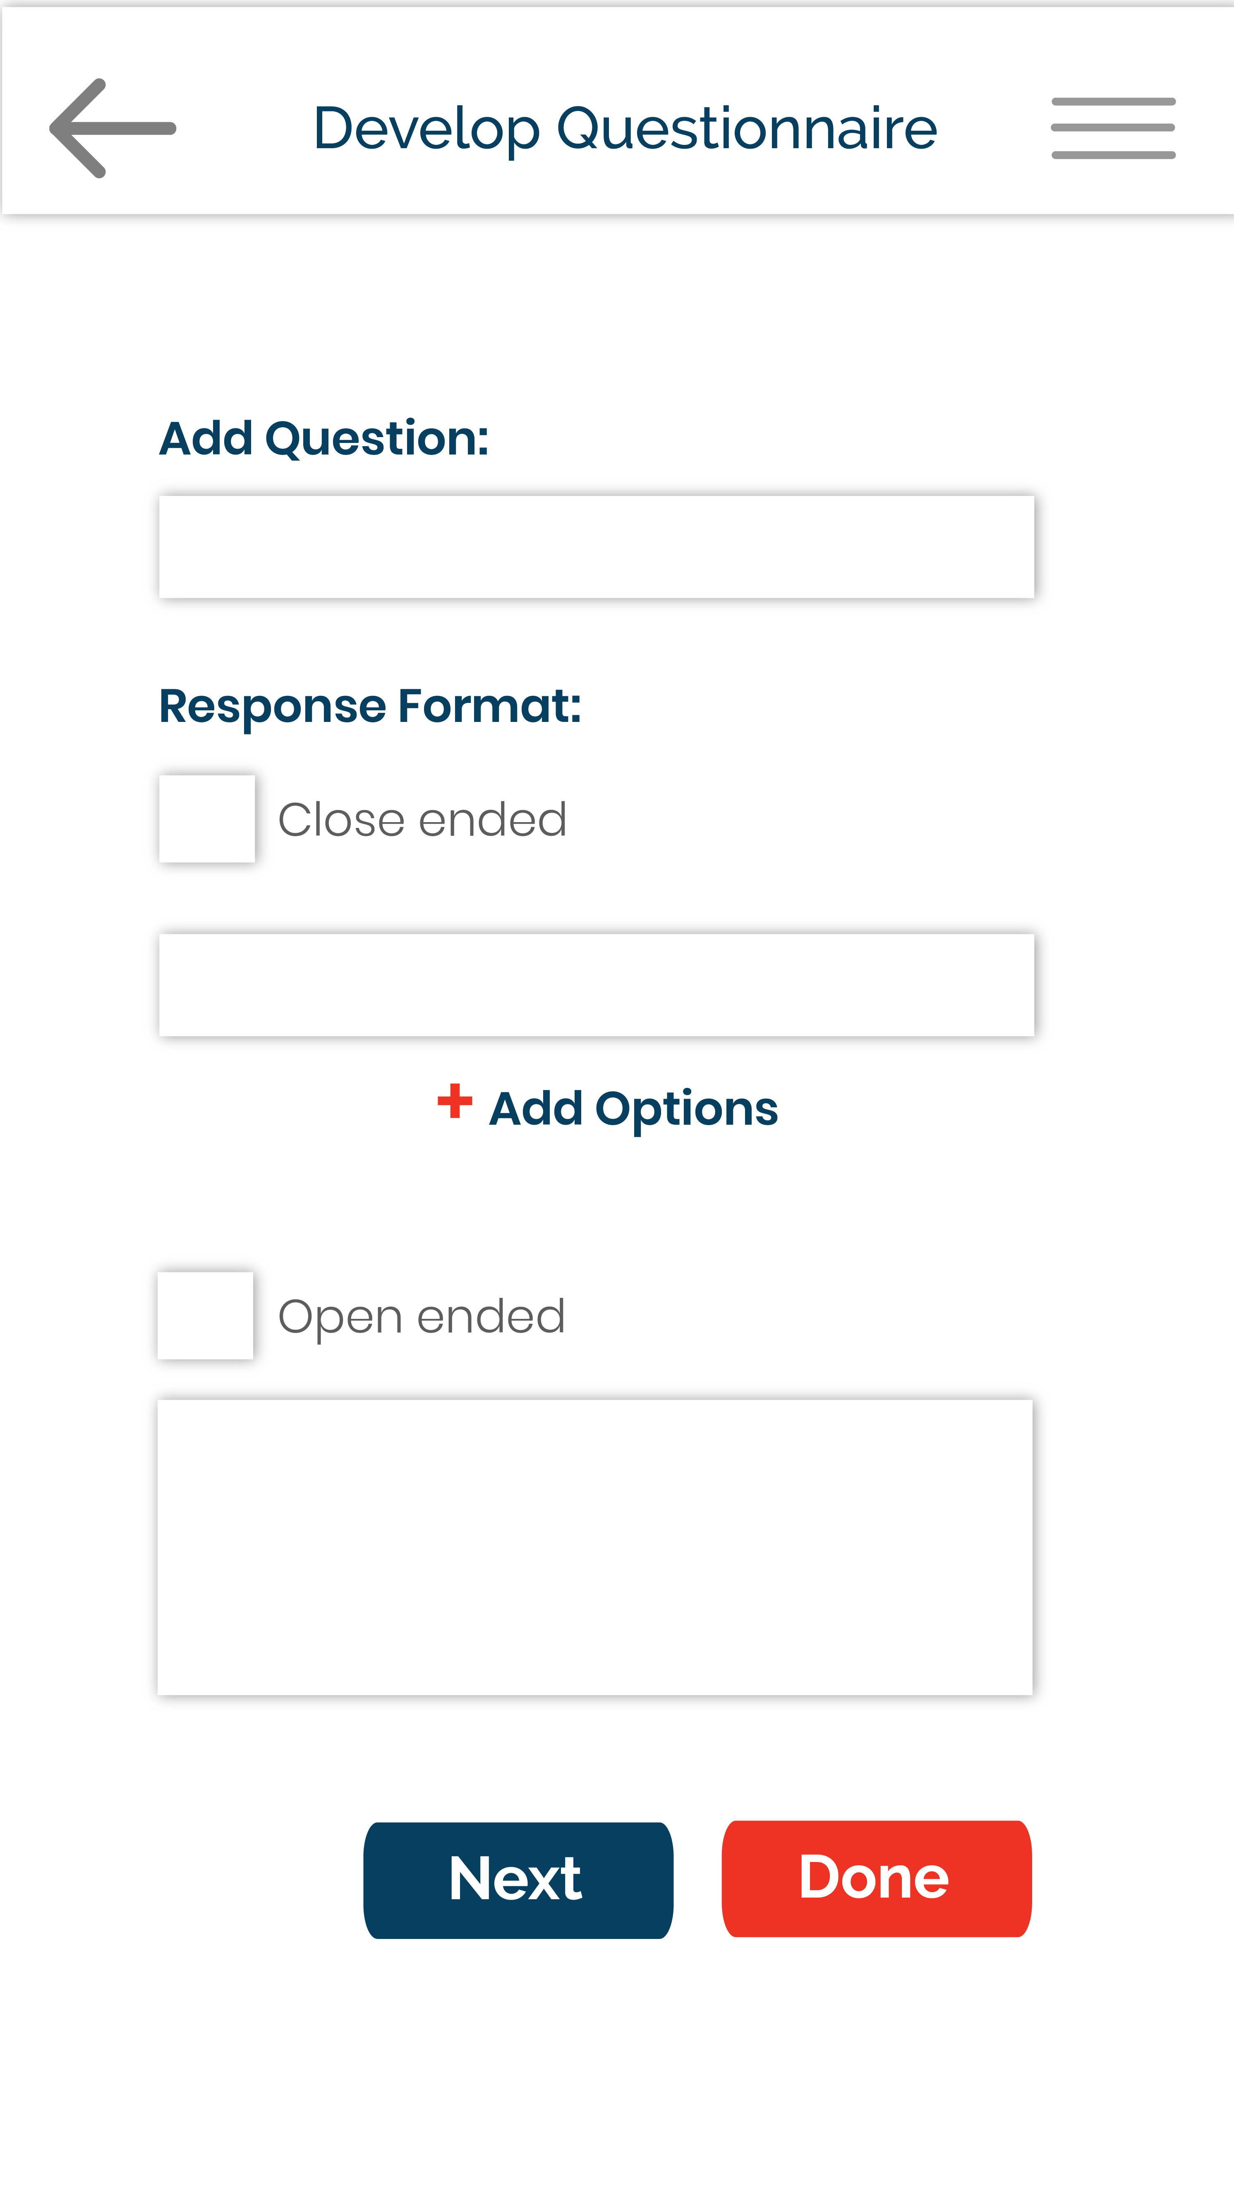

Slide 25
